Slide 1
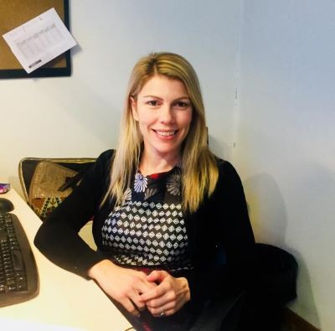
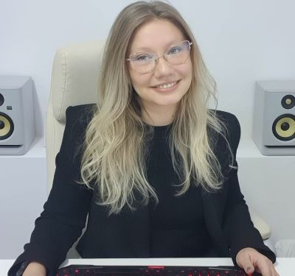
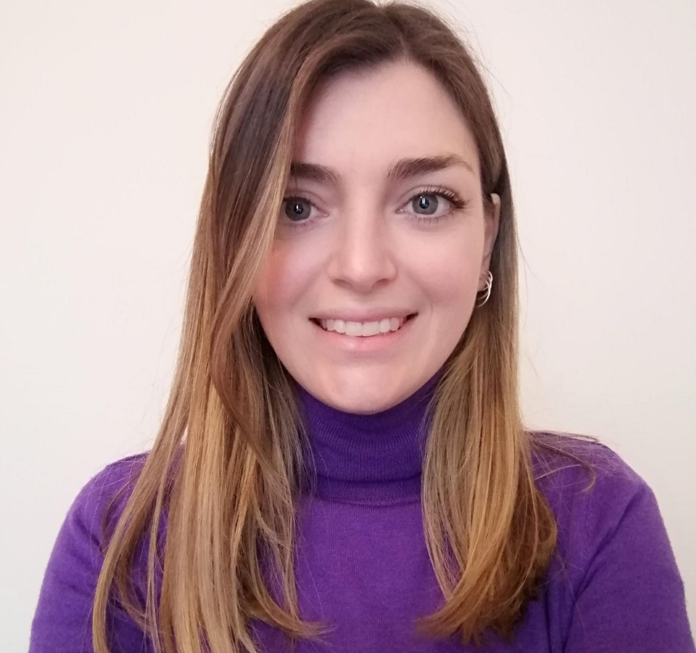
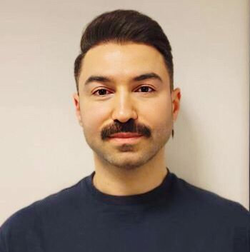
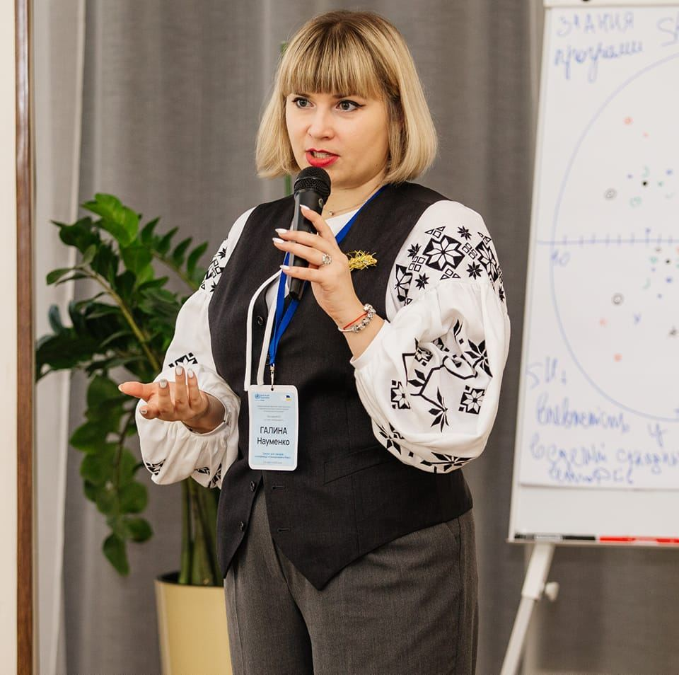
Mental Health Support for Ukraine’s displaced people in European Union
‘Self-Help Plus (SH+) and Doing What Matters (DWM) for Ukrainian refugees: from evidence to implementation’
Join the U-RISE Webinar
Dr. Marianna Purgato
WHO Collaborating Center
University of Verona, Italy
Dr. Monica Bartucz
WHO Collaborating Center
University of Verona, Italy
Dr. Giulia Turrini
WHO Collaborating Center
University of Verona, Italy
Sam Hunaidy
International Medical Corps, Poland
Dr. Galyna Naumenko
Bogomolets National Medical University, Ukraine
23rd May 2023 17:00 CEST | 18:00 Ukraine Time

